Slide 1
Transfer function of DC motor

Slide 2
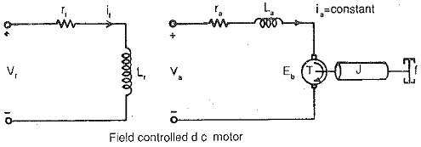
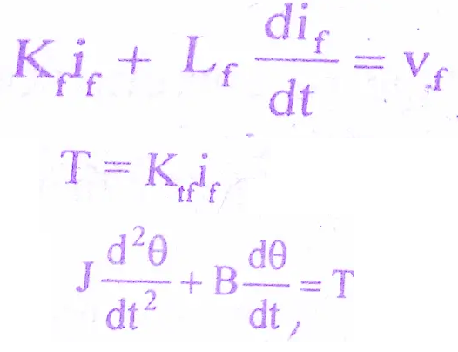
Field controlled DC Motor

Slide 3
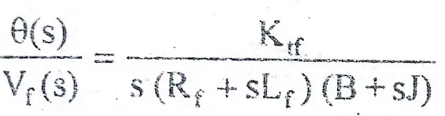
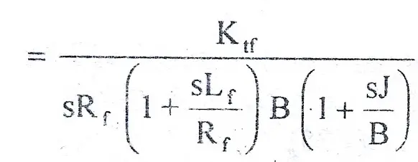
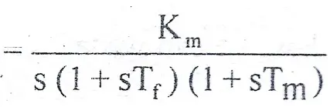
Field control of DC Motor

Slide 4
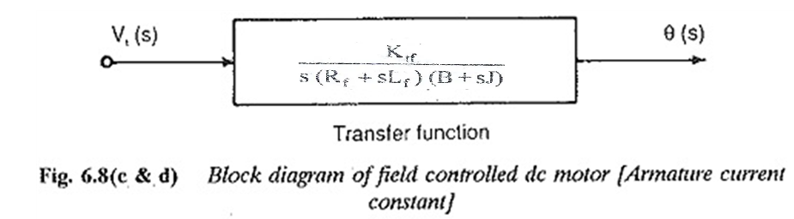

Field control of DC Motor
Where
K_{m} = K₂/(R_{f}.B) motor gain constant
T_{f} = L_{f}/R_{f} field time constant
T_{m} = J/B mechanical time constant.

Slide 5
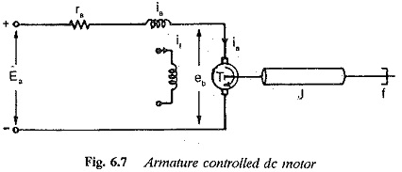
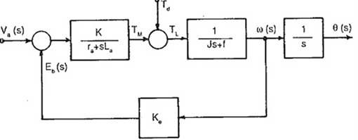

Armature controlled of DC Motor
Note:
Back EMF : Eb = kb dθ/dt
Torque: T∝ ∅ia
∅ means If.
Its proportional to either If (or) Ia Since we keep one parameter as constant and vary the other one.

